Slide 1

Supporting the Tribes and Climate Change Program
  Institute for Tribal Environmental Professionals (ITEP)
  Arizona NASA Space Grant
  Presented by: Meronda Walker
  Mentors: Nicolette Cooley, Kelsey Morales, Karen Cozzetto; Northern Arizona University
  April 17th, 2021

Slide 2
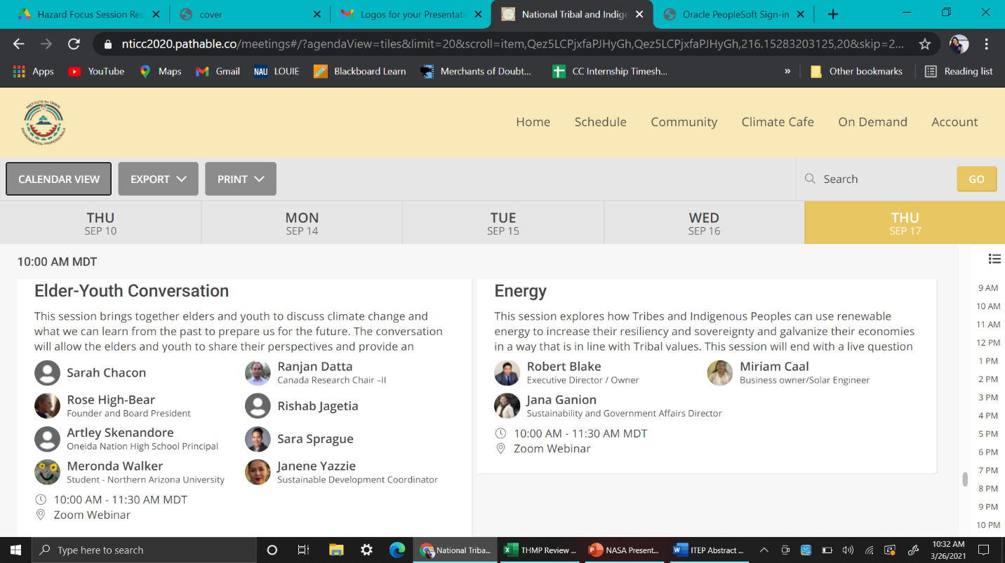
National Tribal & Indigenous Climate Conference (NTICC) September 2020
Speaker at Elder and Youth Session
I wrote a short reflection on my experience which was featured in the December Tribes and Climate Change newsletter.
Reasons Why climate change is important to me:
Affects traditional Culture
Negative impacts to human health
Disrupts natural relations

Slide 3
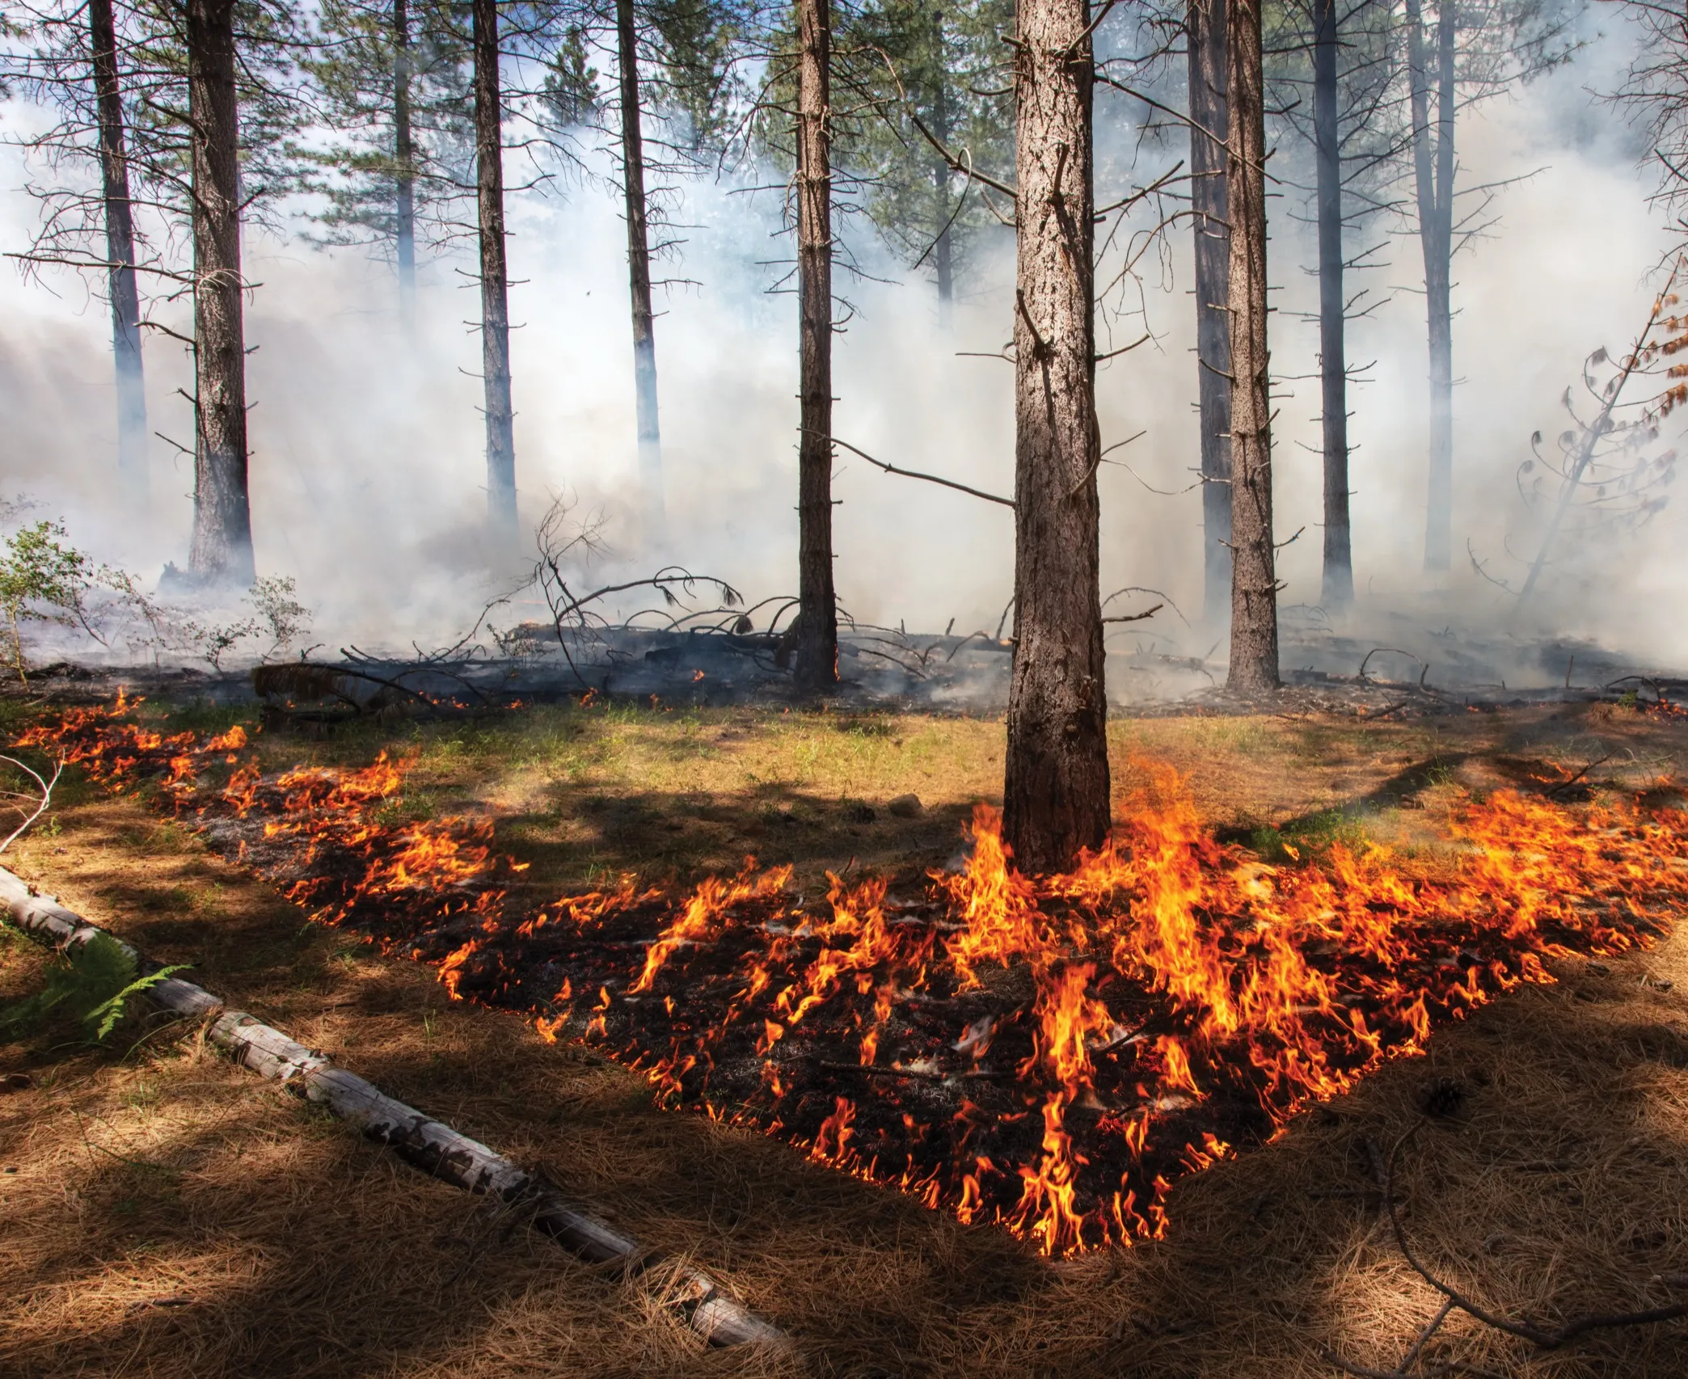
Monthly Webinars
Affiliated Tribes of Northwest Indian’s Climate Change Summit: Tribal Climate Resiliency
Focused on learning about policies and practices that promote Tribal Climate Resiliency in the US and Canada.
Wildfire Hazard Mitigation webinar
Source: The New Yorker

Slide 4
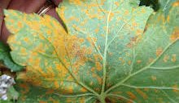
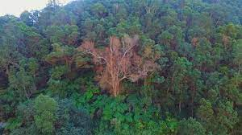
Monthly Webinars (continued)
SCIENCE x Invasive Tree Pests and Pathogens
  White pine blister rust in a changing climate: investigate complex interactions to develop strategies to restore and sustain mountain-top ecosystems, presented by Anna Schoettle.
  Patterns and Impacts of Rapid Ohia Death in Hawaii’s Native Forests: Science-Based Management Approaches, presented by Flint Hughes.
  Thirty Years of Sudden Oak Death: The Consequences of a Pathogen Invasion, presented by Susan Frankel.
Source: University of Massachusetts Amherst
Source: bigislandvideonews

Slide 5
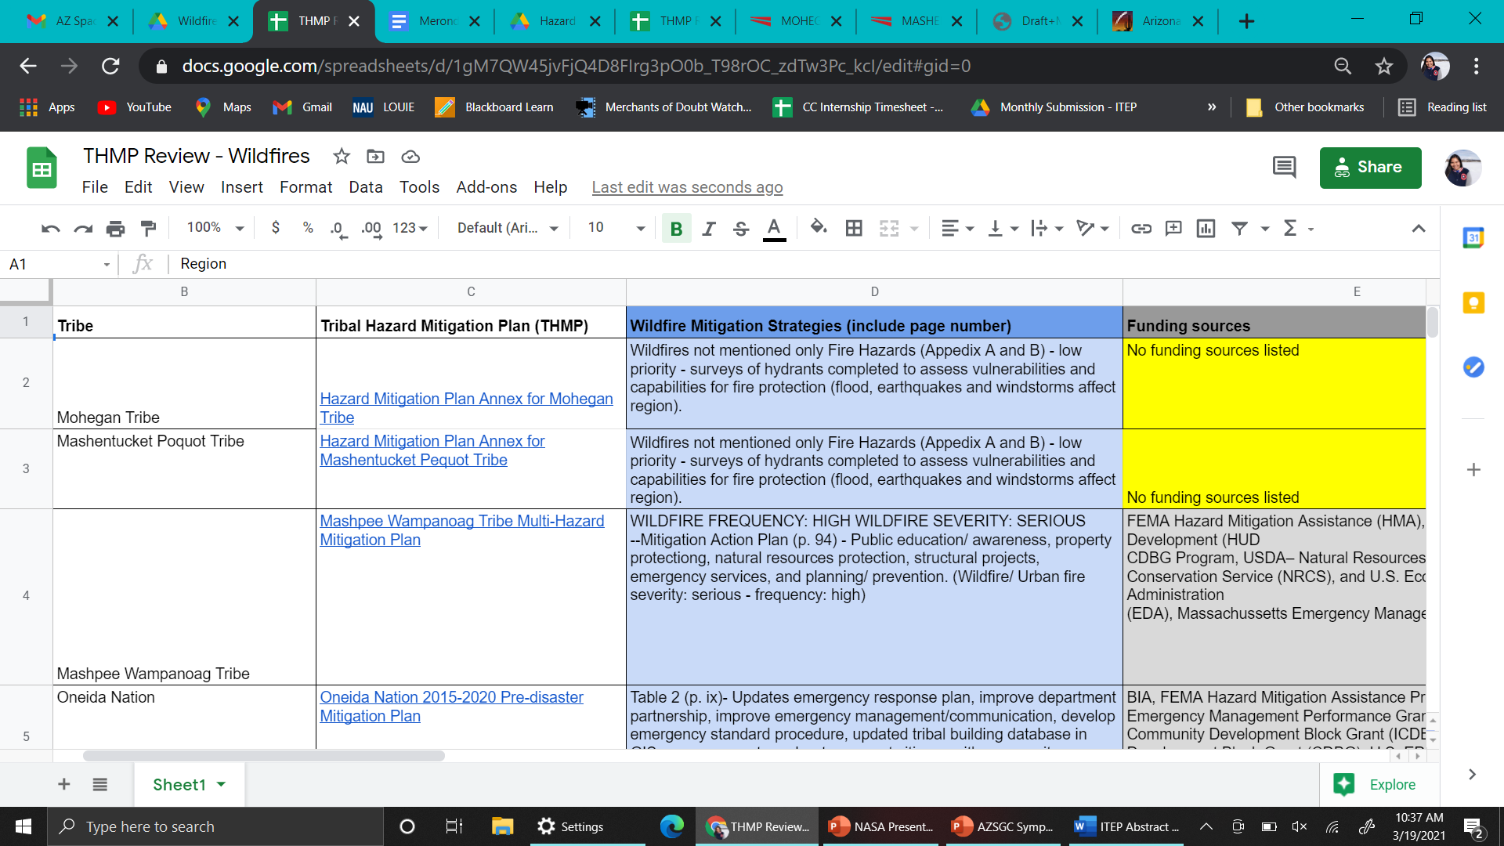
Supported the Climate Change 202: Tribal Hazard Mitigation Planning (THMP) course
Attended weekly group meetings
Compiled hazard mitigation strategies from existing THMPs for hazards such as wildfire and extreme heat.
Additional excel columns:
Data sources
Mentions of climate change

Slide 6
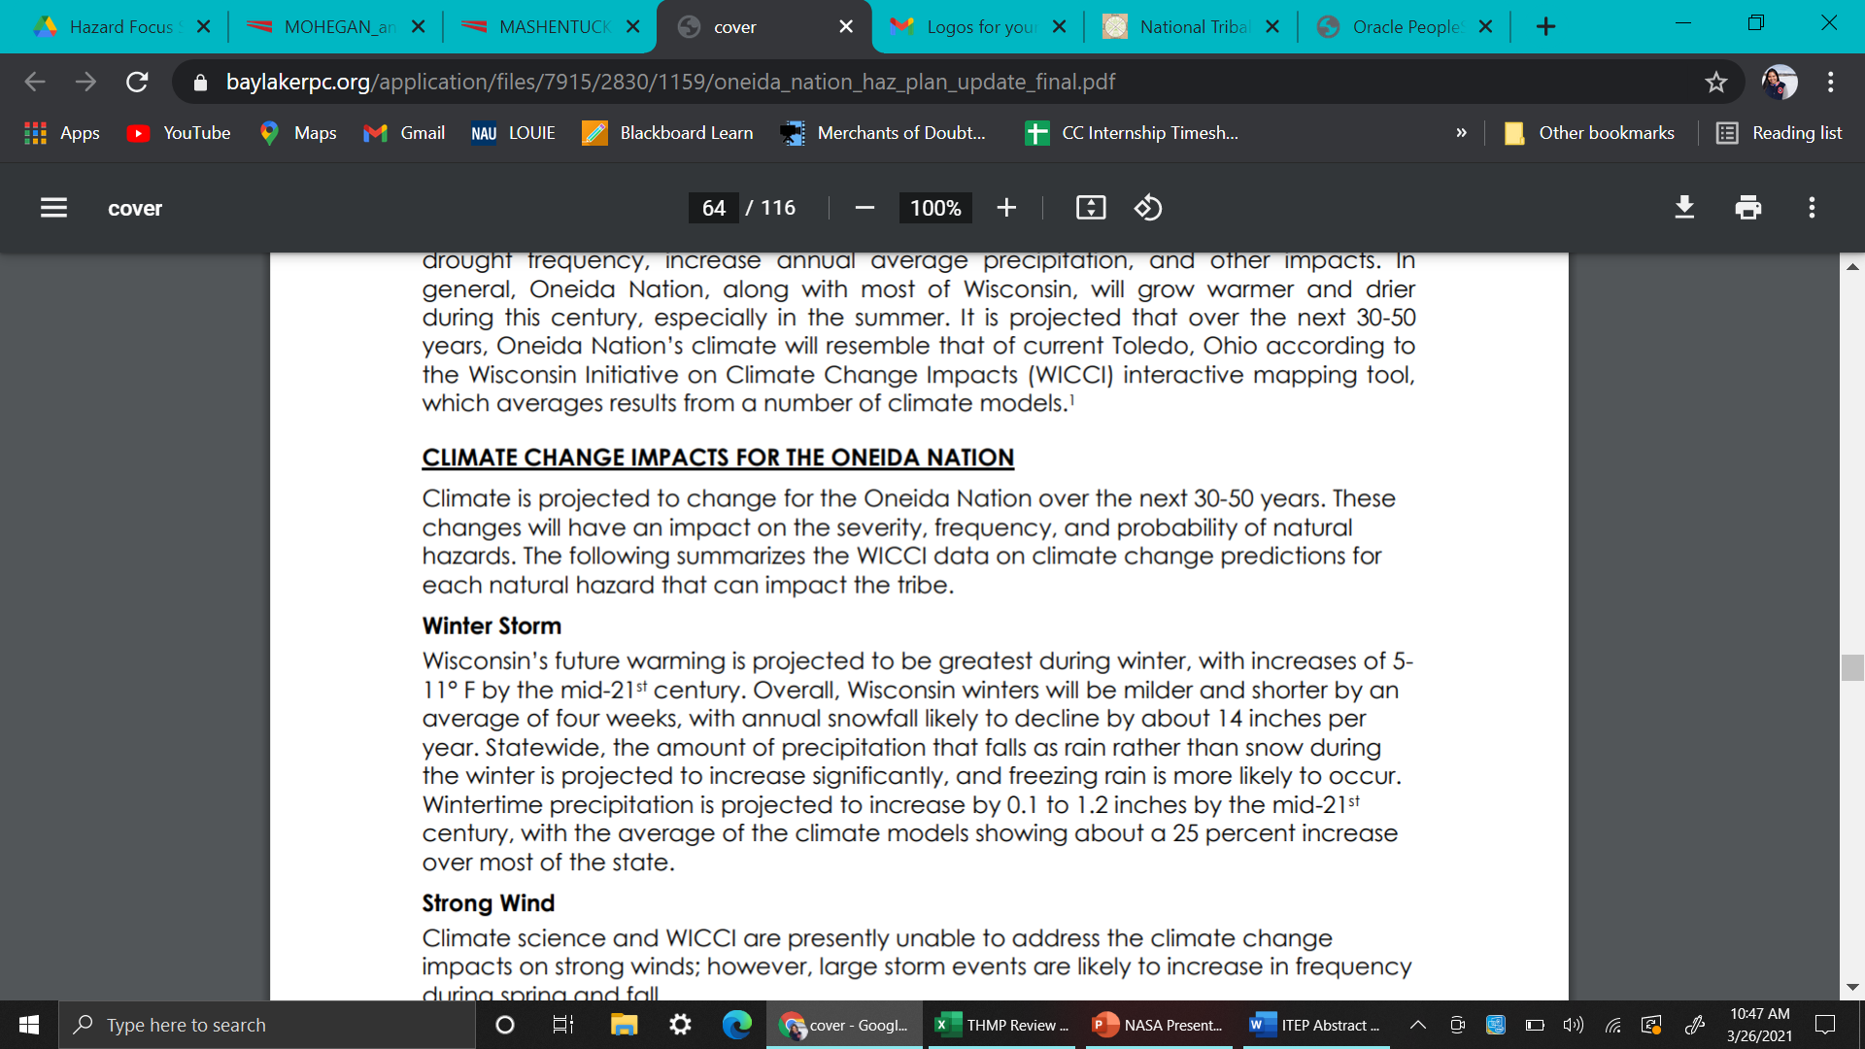
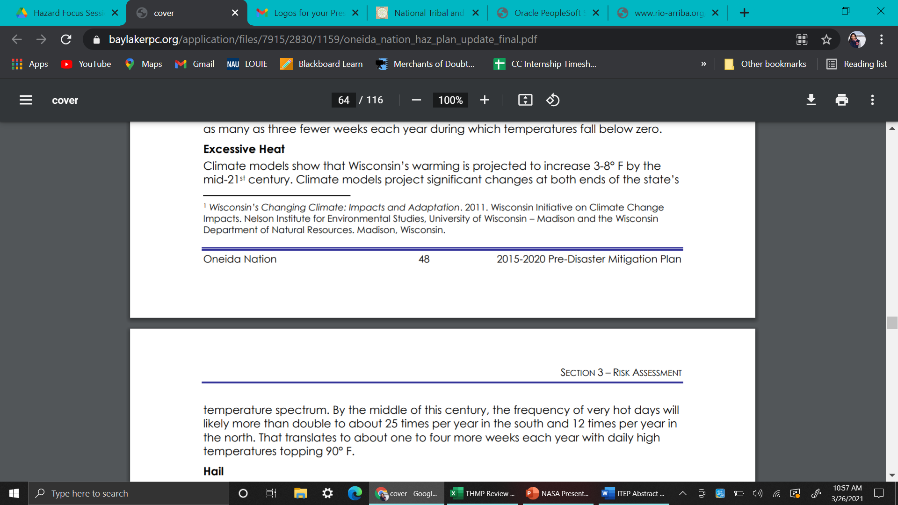
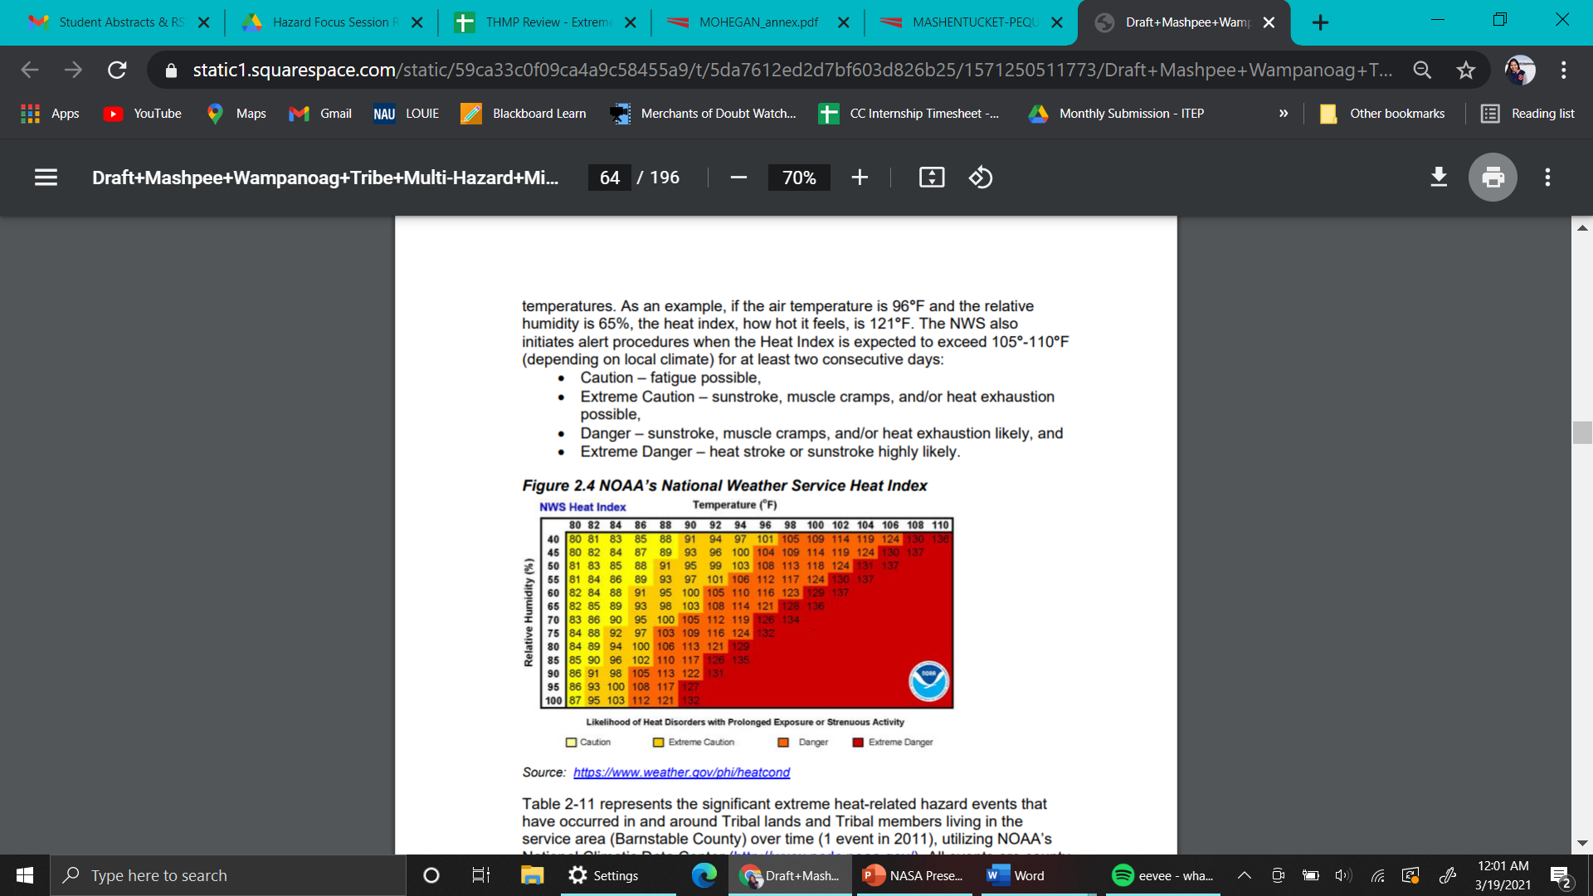
Source: Oneida Nation 2015-2020 Pre-disaster Mitigation Plan
Source: Mashpee Wampanoag Tribe Multi-Hazard Mitigation Plan

Slide 7



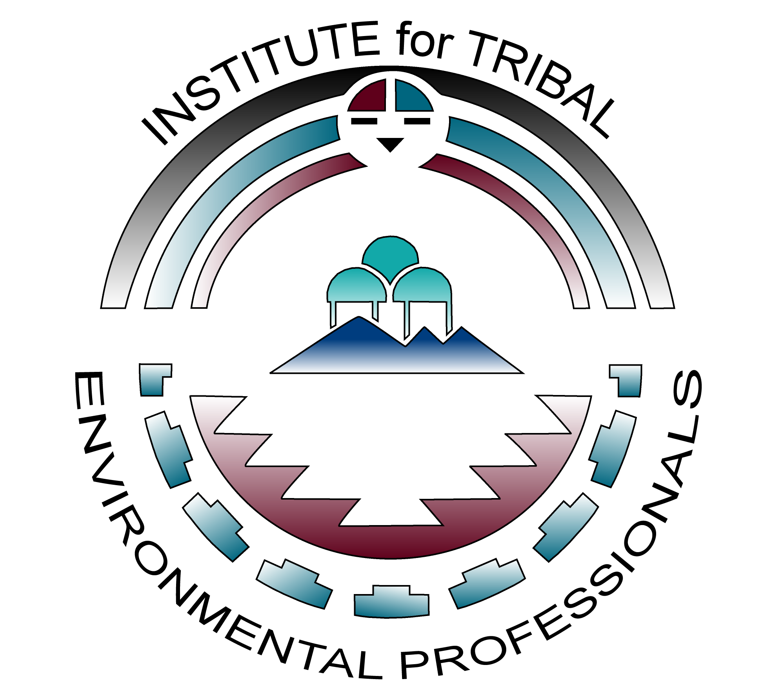
Take-aways
A big thank you to:
CC is a current crisis
  loss of wildlife
  disruption of plant ecology
  ecosystem disruptions
  negative impacts to human health

